Slide 1
Courier Delivery System
Project Members :-
1) Sanket Khatal (RN:- 1151)
2) Ankush Yeshwantkar (RN:- 1218)

Slide 2
Introduction
Courier Delivery System is a web based delivery service within a city, System which supports the high availability of courier services to the business and to the customer.
The system is being used for day to day activities such as booking a courier that is basically a pickup and drop service within city, process data of companies and many other things.
It is programmed using Java technologies. It can be customized to fit your business and can either be used as a complete system or as separate modules.

Slide 3
Scope
This project traverses a lot of areas ranging from business concept to computing field, and required to perform several researches to be able to achieve the project objectives. The area covers include:
The use of the system for better services and fast processing.
Courier facility in India is very cheaper and maximum charges but we can send the courier to destination in minimum charges within city.

Slide 4
Objectives
Specific goals are: -
The main objective of the Courier Delivery System is to manage the details of Package, Email Notification, Payment, Delivery and Customer.
To build an application program to reduce the manual work for managing the package.

Slide 5
Description
Admin:
Admin can login to the system.
View the list of all users.
Add new delivery partner.
Delete customer.
Update delivery partner.
View the list of all delivery partner.
View all reviews.

Slide 6
Delivery Partner:
Delivery Partner can login to the system.
View his/her details.
Update delivery status.
Update their personal credentials.
Delete his/her account.

Slide 7
Customer:
Customer can login to the system.
Customer can place order.
View his/her details.
Update their personal credentials.
Delete his/her account.

Slide 8
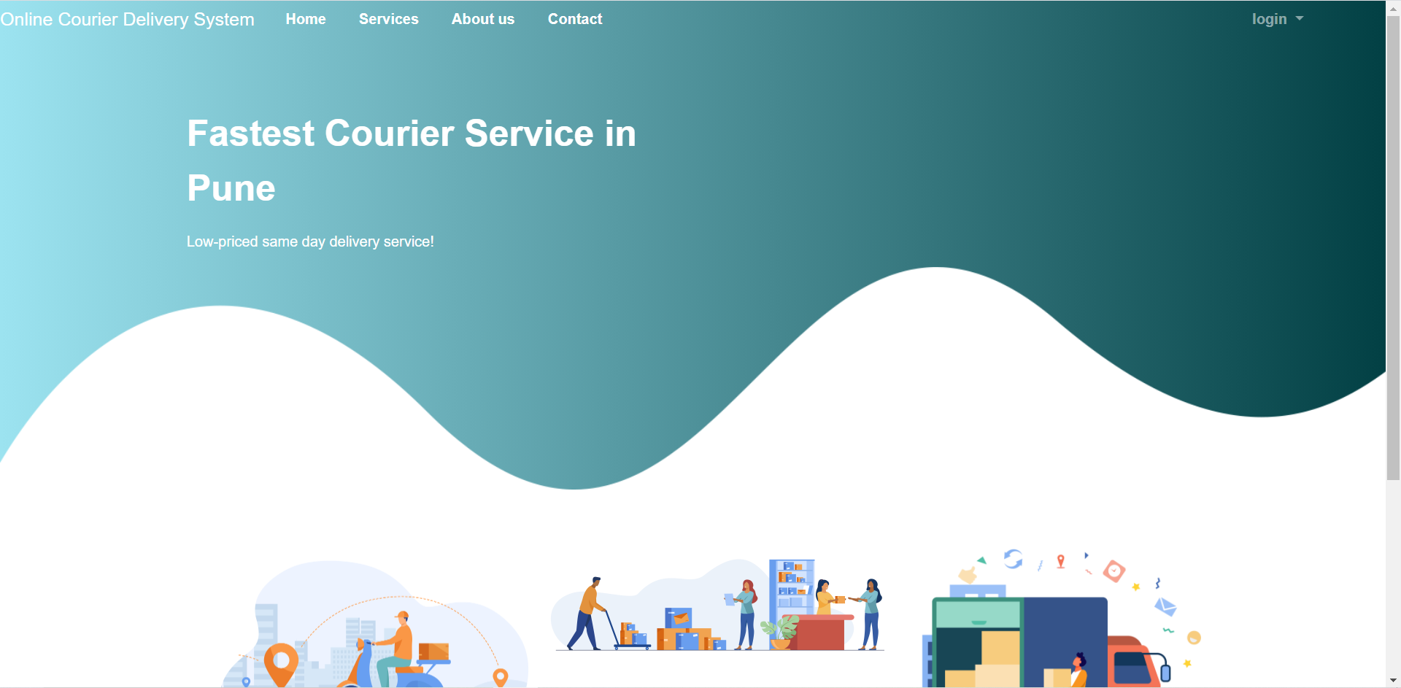
ScreenShots

Slide 9
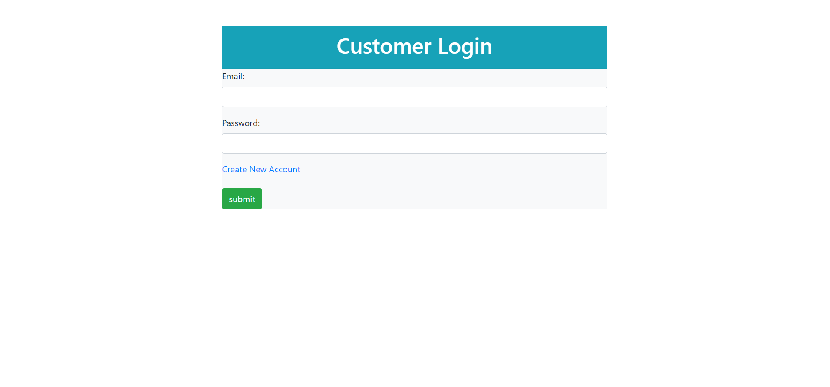

Slide 10
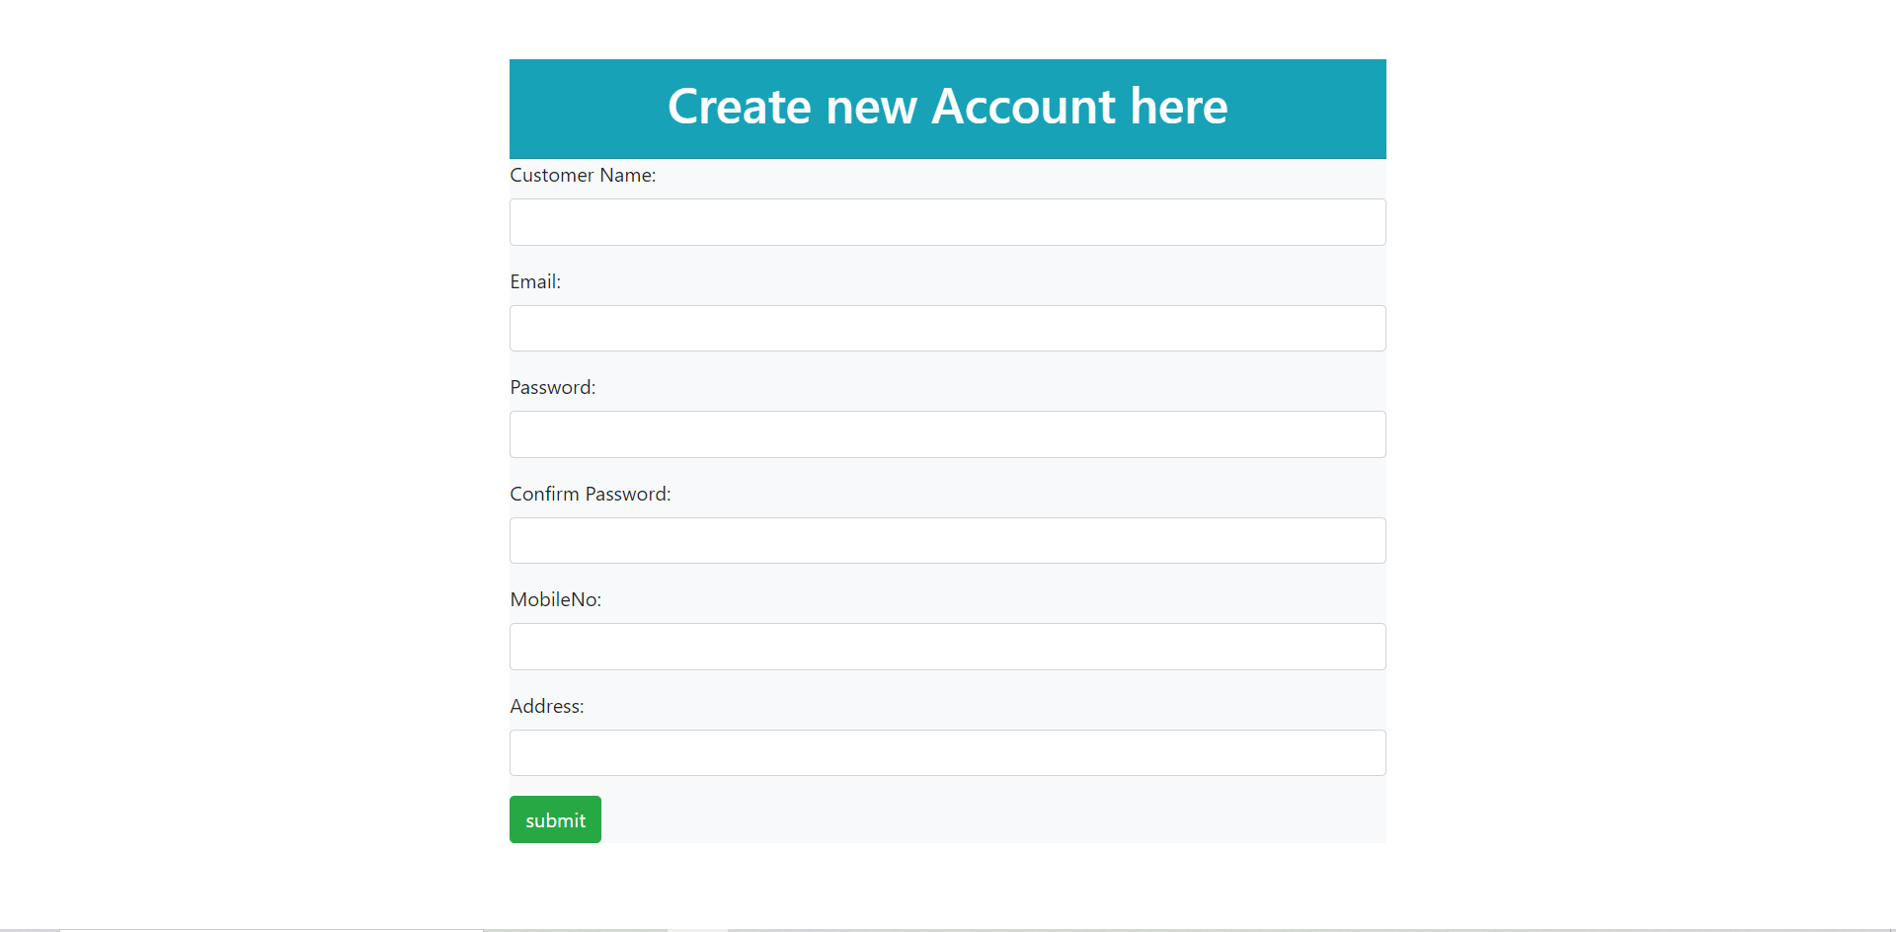

Slide 11
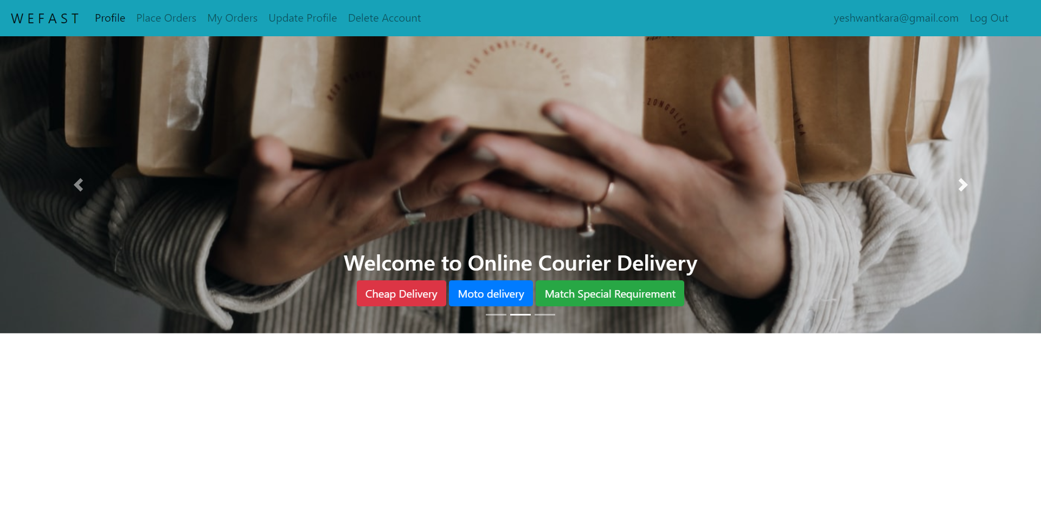

Slide 12
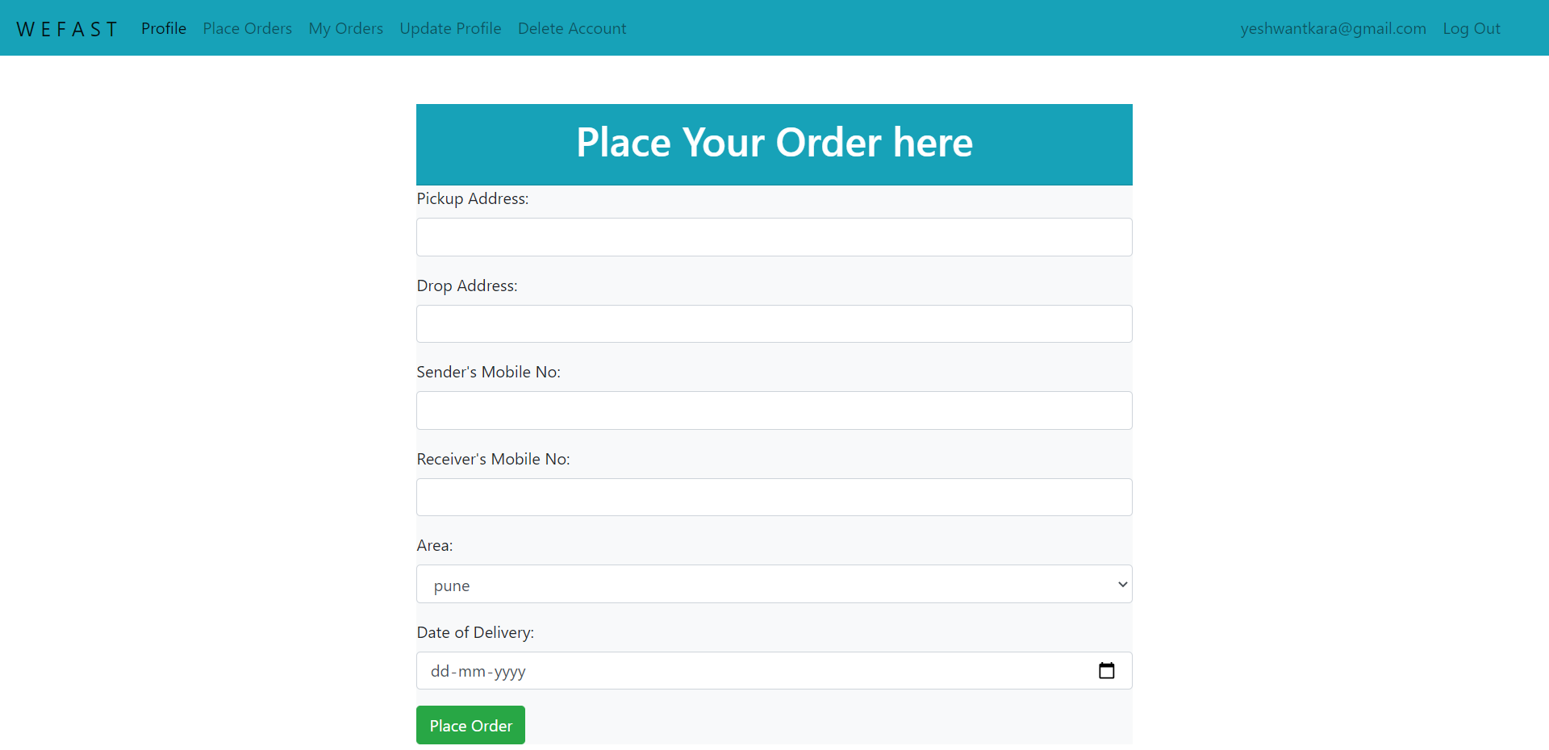

Slide 13
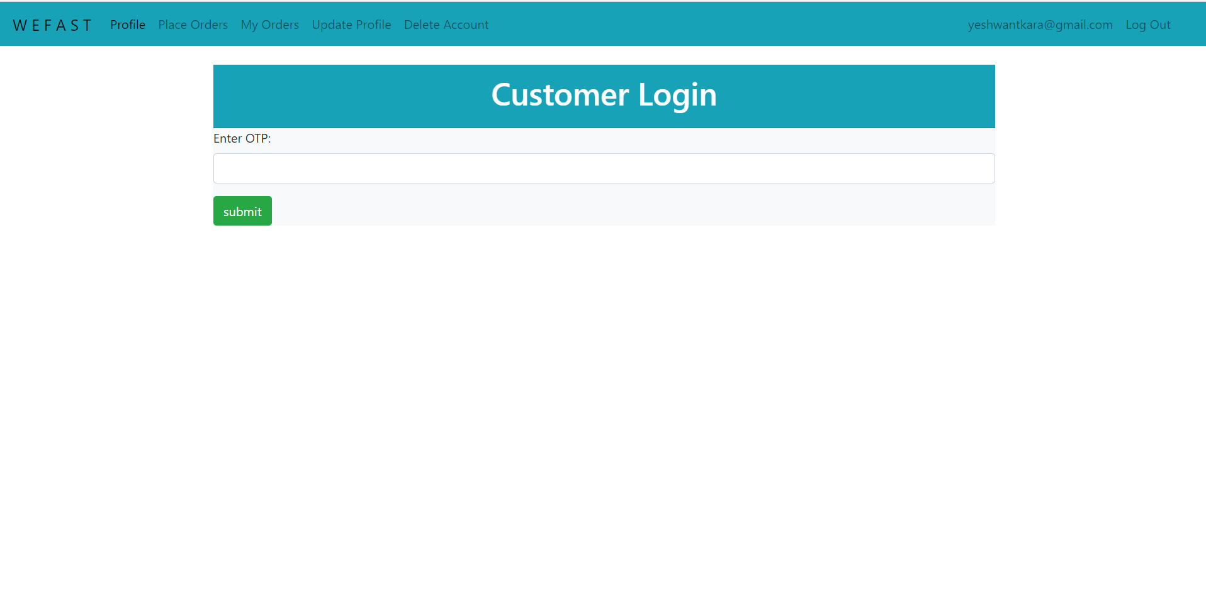

Slide 14
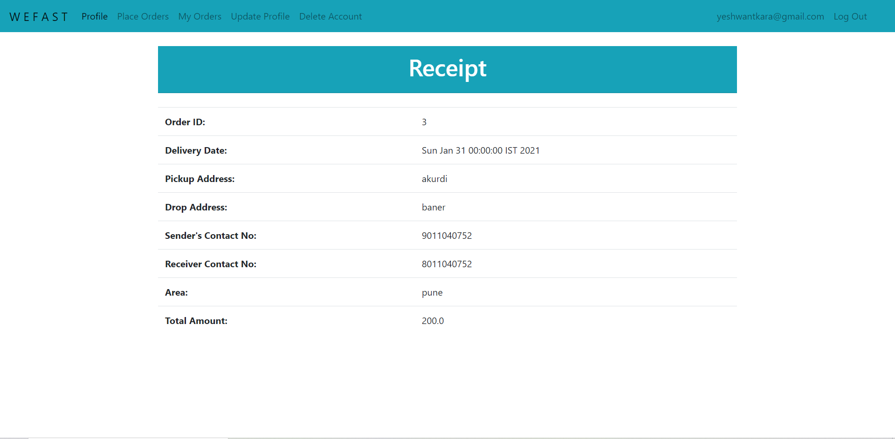

Slide 15
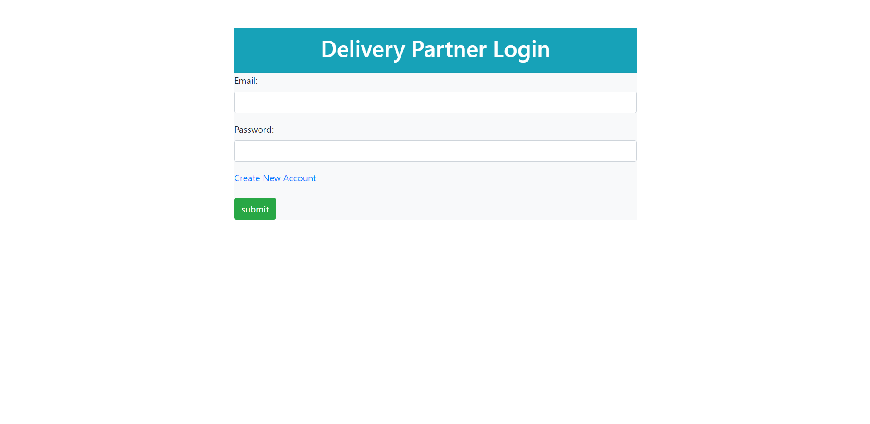

Slide 16
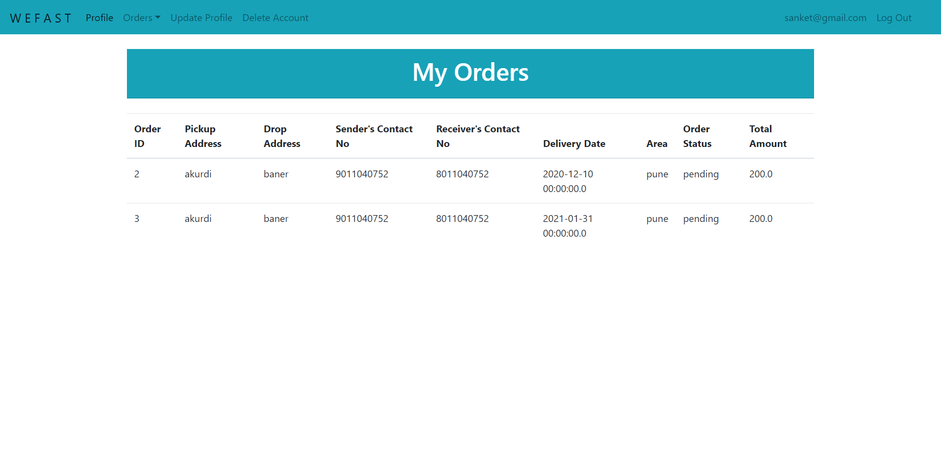

Slide 17
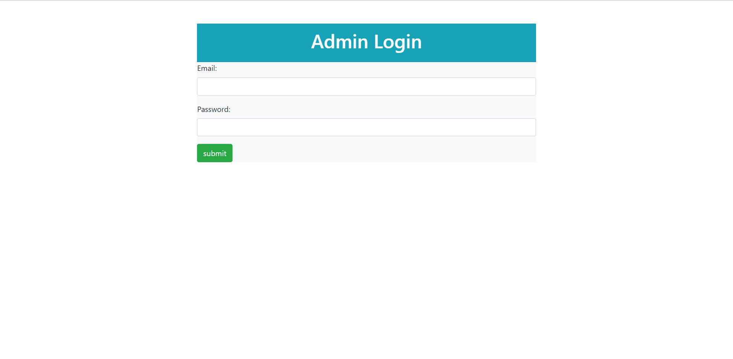

Slide 18
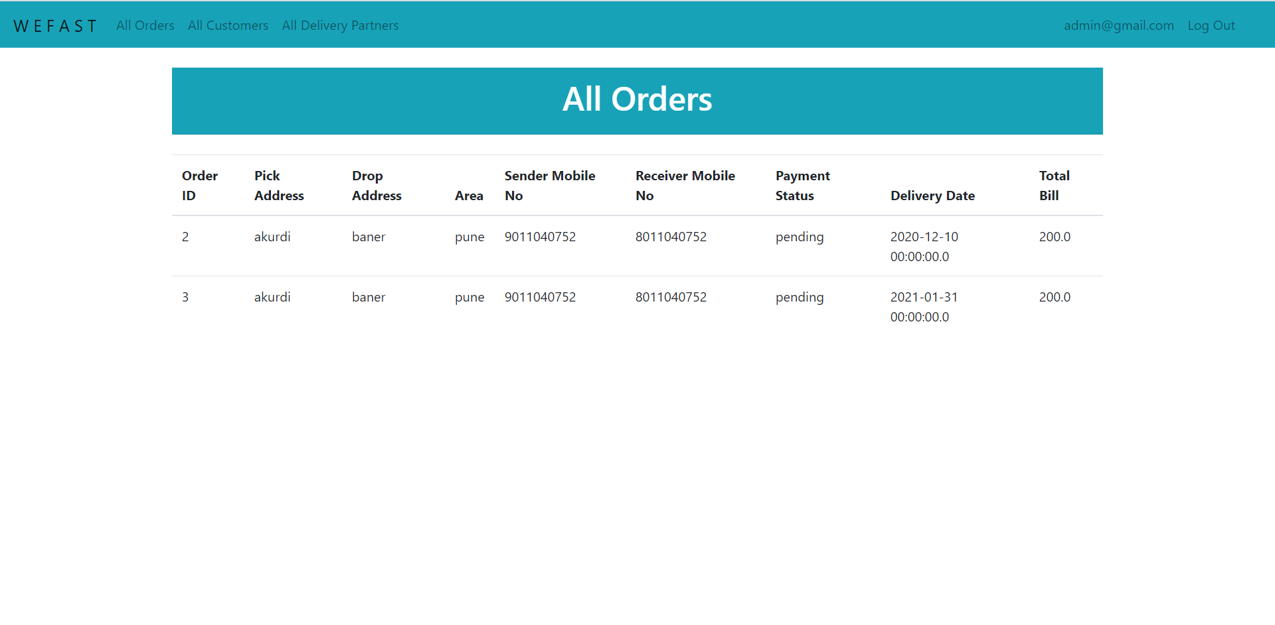

Slide 19
Conclusion
This system is a user friendly and GUI based website. It satisfies all the requirements of the proposed system to a great extent.
This system is developed in a way that it is easy to use and easy to maintain. This system is mainly designed to reduce the cost, to increase the experience of the customer and to increase the operational efficiency.
The system is developed to help the customer to find the location of the package. It helps them to know the package departure status. This added feature makes the user to conveniently use the system.

Slide 20
References
[1] Mr. Nishikant Kumar, Prof. Jayanti T,” A Simple web Application of Courier Management System”, IJERP.
ONLINE REFERENCE
[2] Learning spring boot, angular and MySQL to create responsive website.
[3] Javatpoint website for core java concepts.
[4] Tutorials point website for learning MySQL.

Slide 21
Thank You!!

